Slide 1

Understanding Identifiers

Slide 2
Learning Objectives
Learn how identifiers are used to filter data, merge datasets, and track entities or securities through time
Understand the difference between universal and proprietary identifiers
understand the distinction between universalU

Slide 3
Identifiers
Identifiers are values that correspond to an entity or security.
Identifiers are useful to:
Filter data
Merge datasets
Track entities or securities through time

Slide 4
Identifiers (cont.)
Header vs. Historical Identifiers
Headers are the most current identifiers.
Historical identifiers have date ranges in which they are valid.
Understand which type of identifier your data uses.

Slide 5
Identifiers (cont.)
Issue vs. Company Specific
Understand if the identifier corresponds to the security or entity within your data.
Date Range of Different Datasets
Understand if data ranges are associated with the identifiers or dataset.

Slide 6
Identifiers (cont.)
Universal Identifiers:
Company Name
Ticker
CUSIP
SEDOL
ISIN
FIGI (Bloomberg ID)
CIK

Slide 7
Identifiers (cont.)
Proprietary identifiers:
CRSP Permno / Permco
Compustat GVKEY
Capital IQ Company ID
IBES Ticker
Option Metrics Security ID / Option ID
Markit RED code
Factset Entity ID / Perm Sec ID

Slide 8



Company Name
Character string
Often abbreviated or manipulated by the data vendors causing different variations
Compustat:
CRSP:
CUSIP:

Slide 9
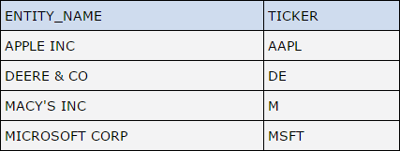
Ticker
Widely used and frequently recognizable
Can change at any time and can be reused by a different company
One company can have multiple tickers.
Usually 3 or 4 characters

Slide 10
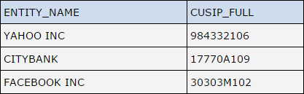
CUSIP
CUSIP = Committee on Uniform Securities Identification Procedures

Slide 11
CUSIP (cont.)
Widely used in databases to identify securities in USA and Canada
Changes infrequently and never reused
Not free. A CUSIP license should be purchased.
Can be 6, 8, or 9 characters.
First 6 characters identify the issuer
Seventh and eighth identify the issue
Ninth character is a check digit

Slide 12
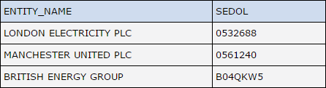
SEDOL: Stock Exchange Daily Official List
Used for identifying securities in the UK
Consists of 7 alphanumeric characters

Slide 13
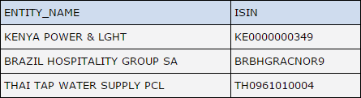
ISIN
ISIN = International Securities Identification Number

Slide 14
ISIN (cont.)
Used for identifying securities from all countries
Consists of 12 alphanumeric characters
The first 2 characters identify country of origin.
The 3rd to 11th characters are unique characters.
For USA, these correspond to the CUSIP identifier.
The 12th character is a check character.

Slide 15
FIGI (Bloomberg ID): Financial Instrument Global Identifier
Twelve alphanumeric character string:
First and second characters should be a non-vowel letter.
Third character is the letter “G.”
Fourth through eleventh characters can be any alpha numeric values excluding vowels.
Twelfth character is a check digit.

Slide 16
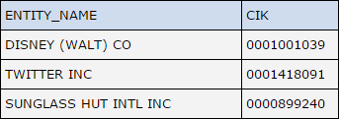
CIK: Central Index Key
Used to identify corporations and individual people who have filed disclosures with the SEC
Ten digit number
Rarely changes and never reused

Slide 17
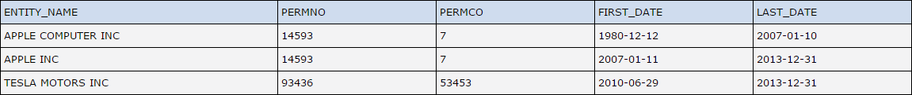
CRSP Permno/Permco
1. Permno identifies securities.
Permno is mapped to historical tickers, company names, etc., with start and end dates in an event file.
Permno is a 5 digit number.
2. Permco identifies companies.
Permco is a number.
3. Permno and Permco do not change when a company changes their name or ticker.
4. Never reassigned

Slide 18
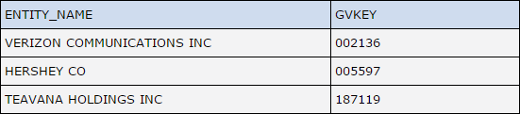
Compustat GVKEY:
Represents a company
Is mapped to the most recent ticker, company name, etc.
Usually a 6 digit number
Does not change through the life of a company

Slide 19
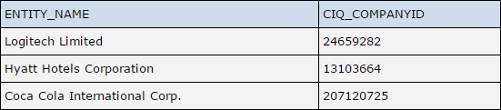
Capital IQ Company ID
Unique, permanent numeric identifier for a companies in Capital IQ

Slide 20

IBES Ticker
Unique identifier assigned to each security
Mapped to historical tickers, company names, etc.
Does not change when companies change name, official ticker, CUSIP/SEDOL, etc.
Do not confuse with official ticker

Slide 21
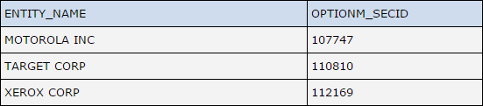
Option Metrics Security ID / Option ID
Security ID (OptionM_SECID) is a unique security ID issued by Option Metrics.
There are too many Option IDs for each company so they are not included in the code look up.
IDs are never reused.

Slide 22
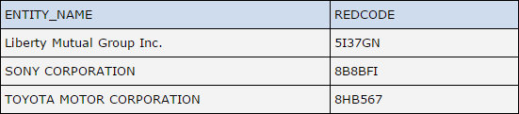
Markit RED code: Reference Entity Database Code
Assigned to each reference entity
6 or 9 alphanumeric characters

Slide 23
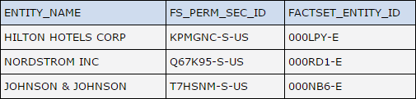
Factset Entity ID / Perm Sec ID
Factset entity ID (FACTSET_ENTITY_ID) identifies organizations and individuals.
8 characters
Perm sec ID (FS_PERM_SEC_ID) is unique identifier for securities.
Never changes
Last 2 characters represent the region code for the country in which the security trades.
Use the entity ID for most purposes

Slide 24
Choosing an Identifier
Proprietary identifiers can be efficient when working with one dataset.
Universal identifier should be utilized to merge separate datasets.
CUSIP or ISIN can be most effective
Use CUSIP to link GVKEY and Permno
Use ticker or company names as a last resort, or use with specific dates.

Slide 25
Additional Help
For any questions, you can contact WRDS at:
https://wrds-www.wharton.upenn.edu/contact-support/

